Slide 1
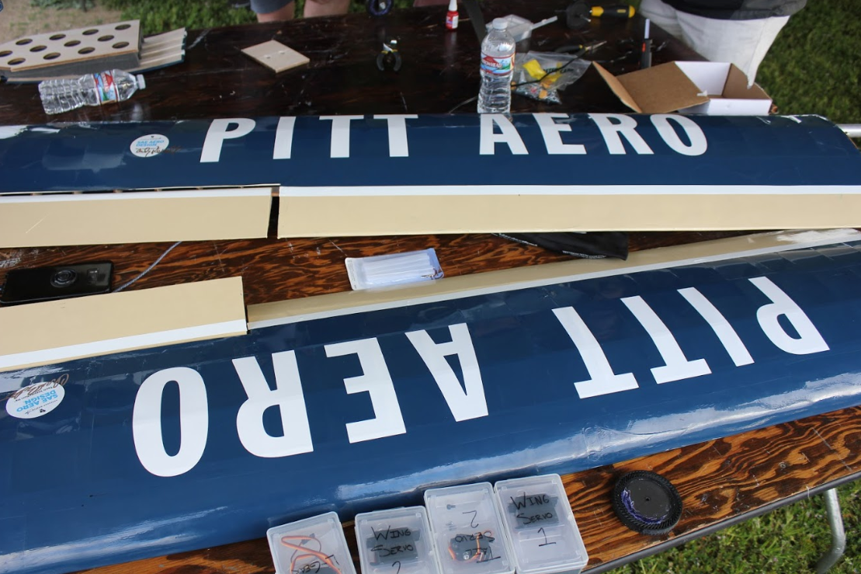
Wing meeting 1

Slide 2
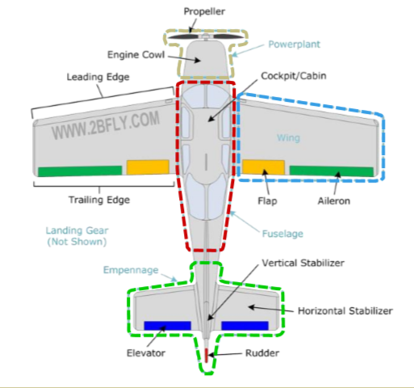
Intro to WinG
Provide lift and controls roll of the aircraft
Design season and manufacturing season
Initial design, CFD, SolidWorks

Slide 3
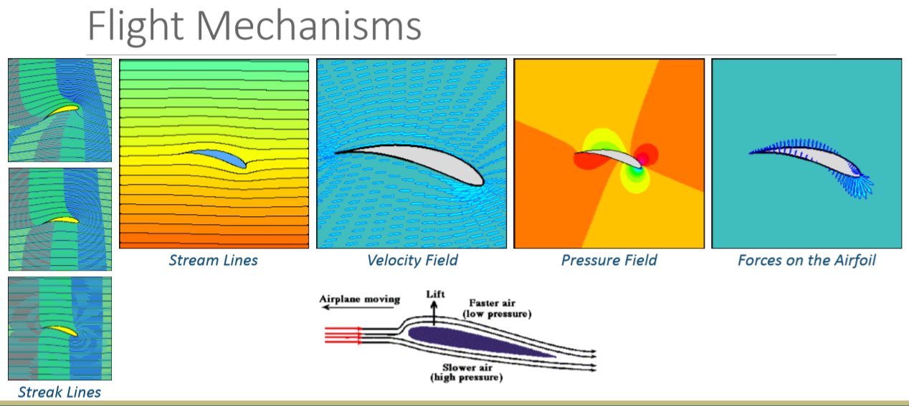
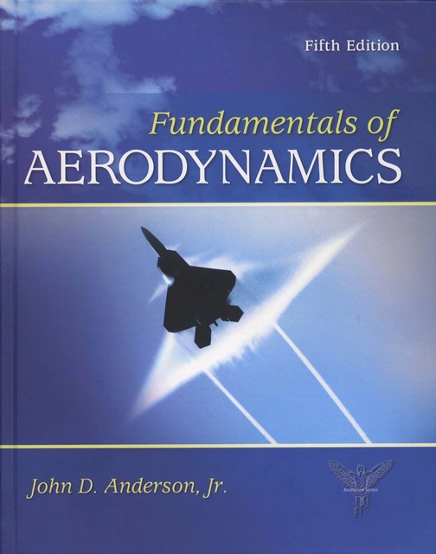
Modeling and cfd

Slide 4
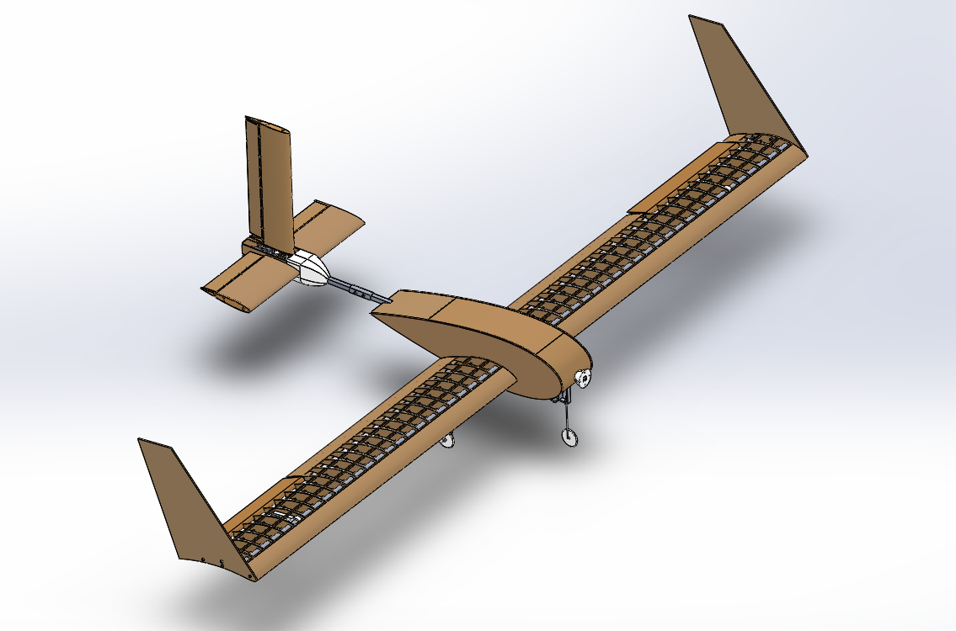
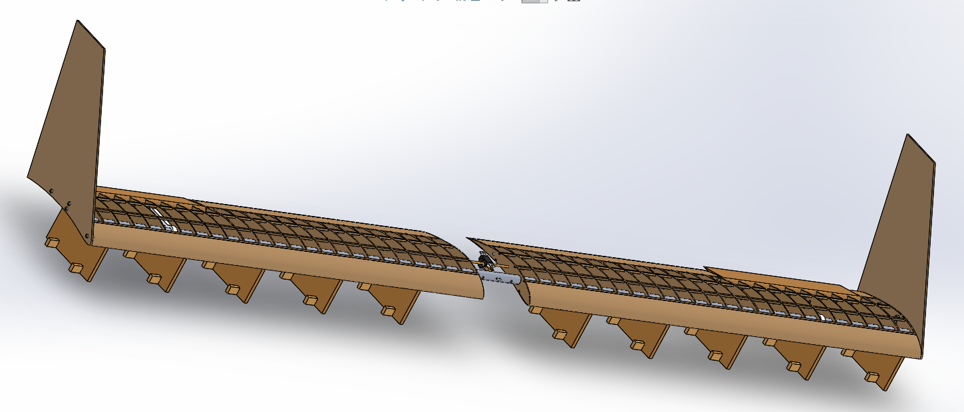
Modeling and cfd

Slide 5
Design season
Design the wings corresponding to the rules for the new year (released?)
Max length
Airfoil shape, length, taper, wingtips, etc.
Aerodynamics, CFD, minimize weight
Design with manufacturing in mind
Wing and plane assembly

Slide 6
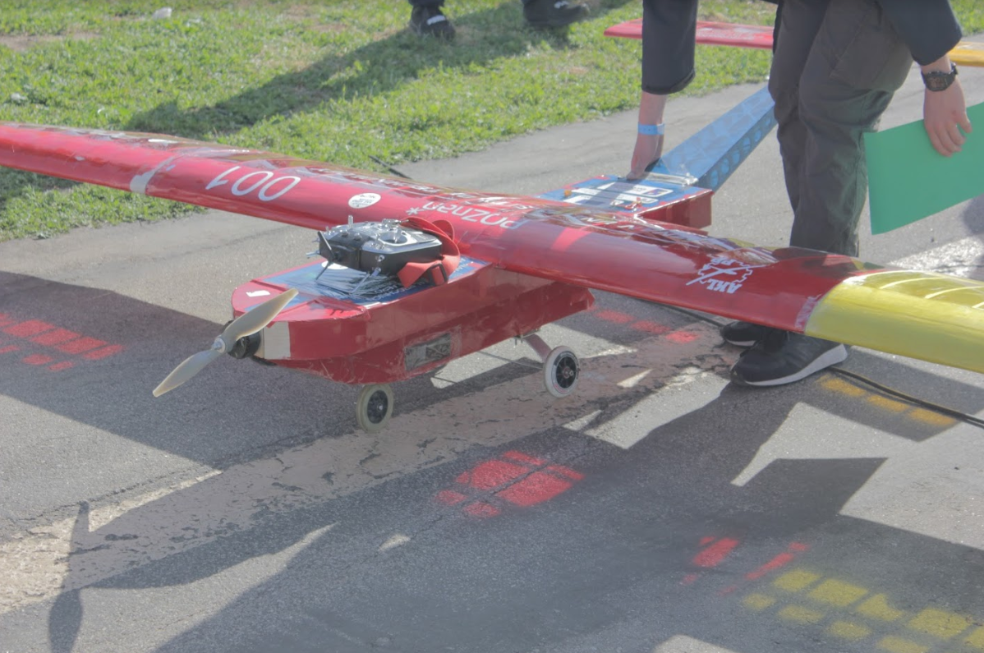
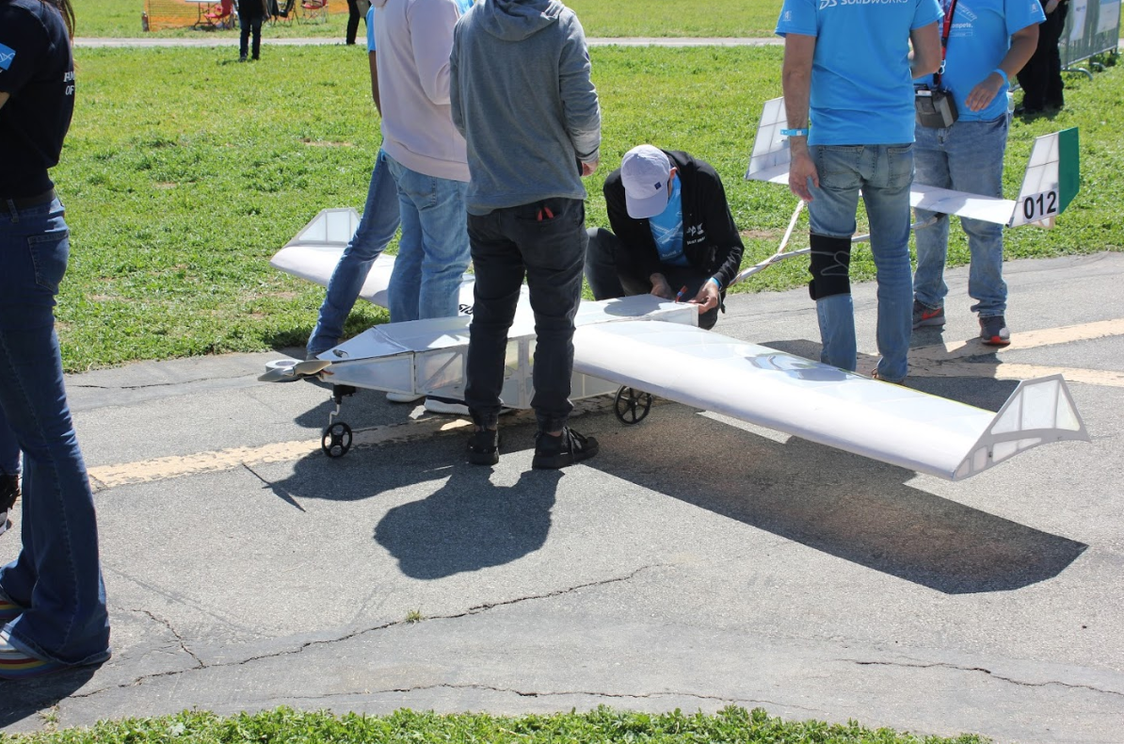
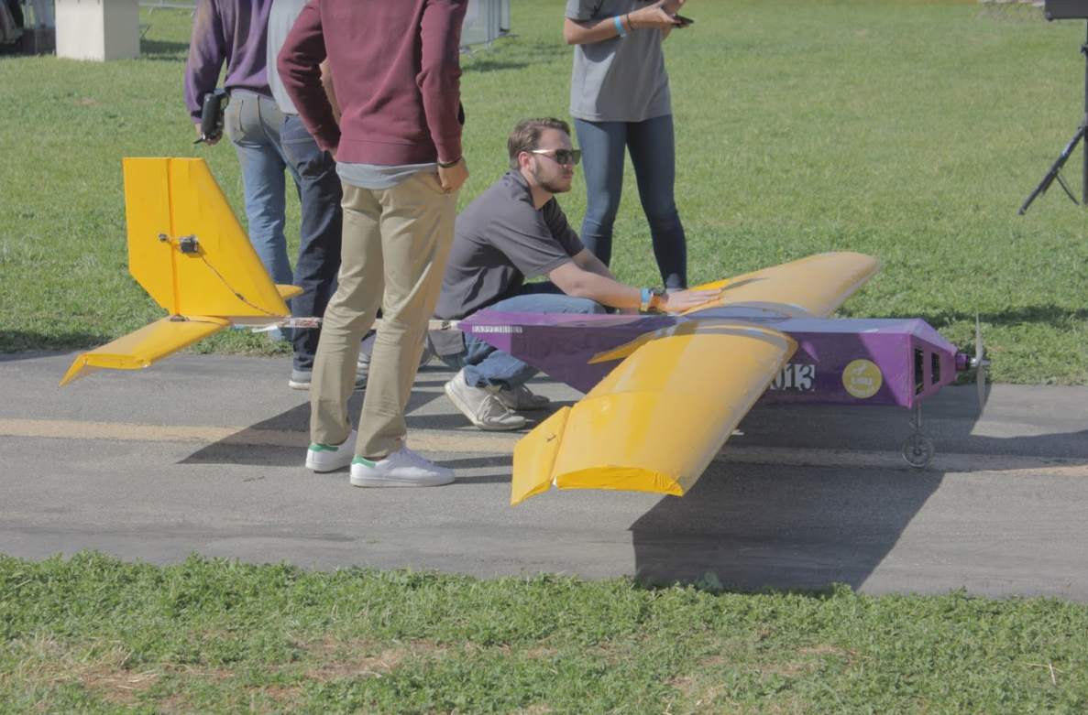
Design season

Slide 7
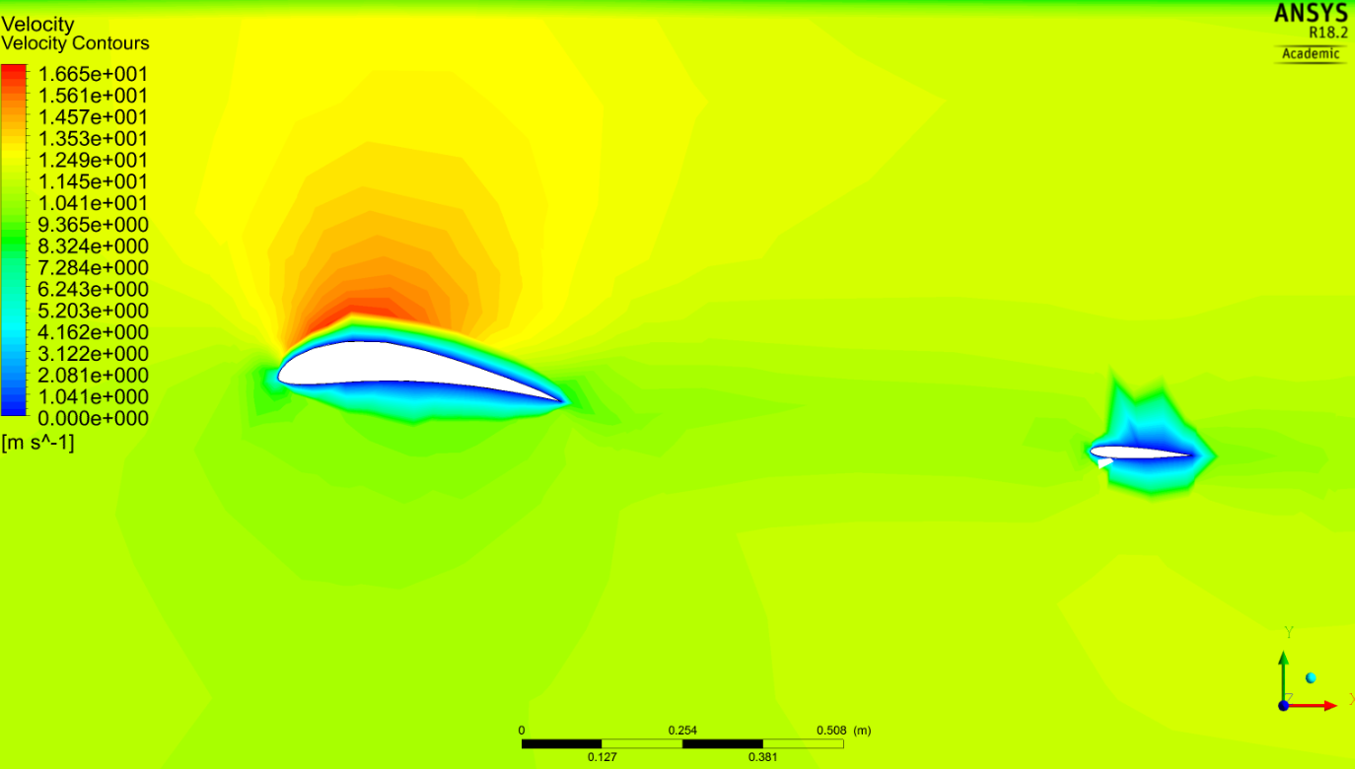
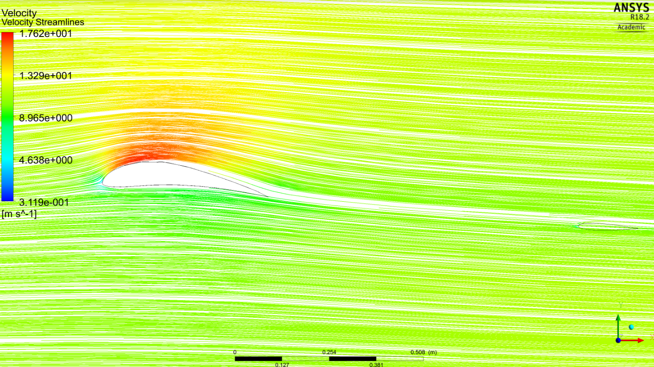
Design season
Need more CFD this year (ANSYS, MIT AVL, Open FOAM)
Need to utilize prototyping tools (Excel, MATLAB)

Slide 8
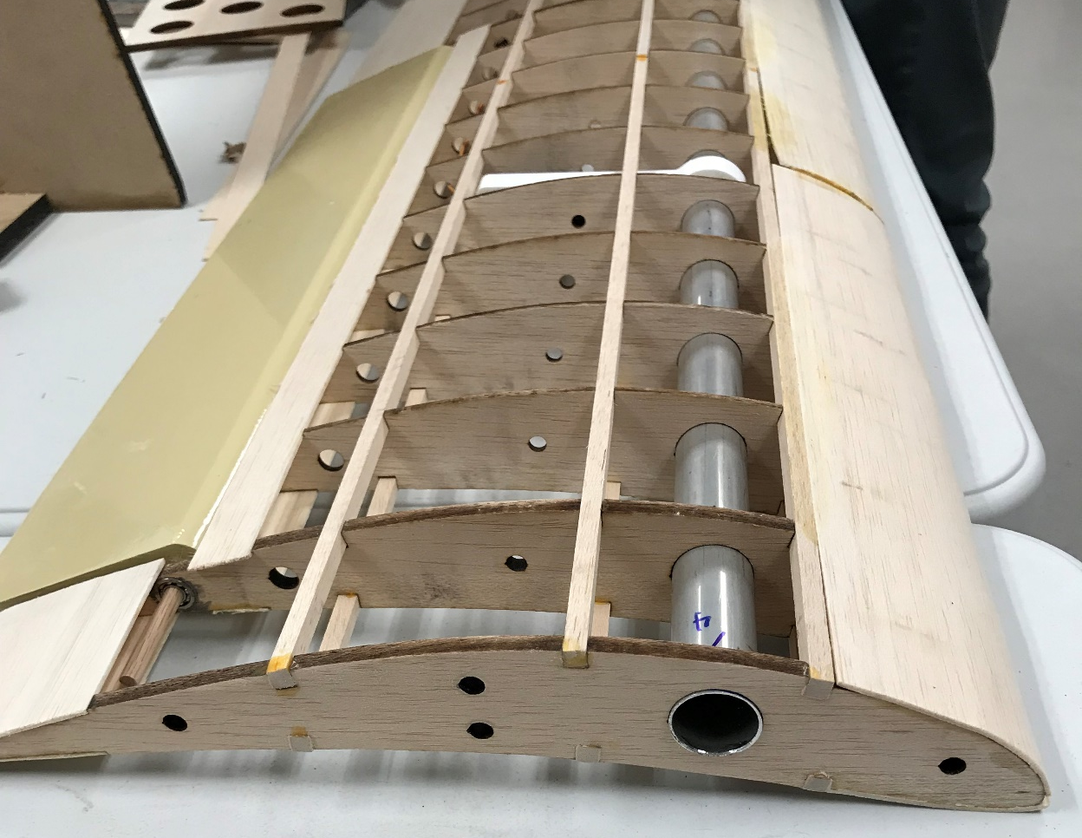
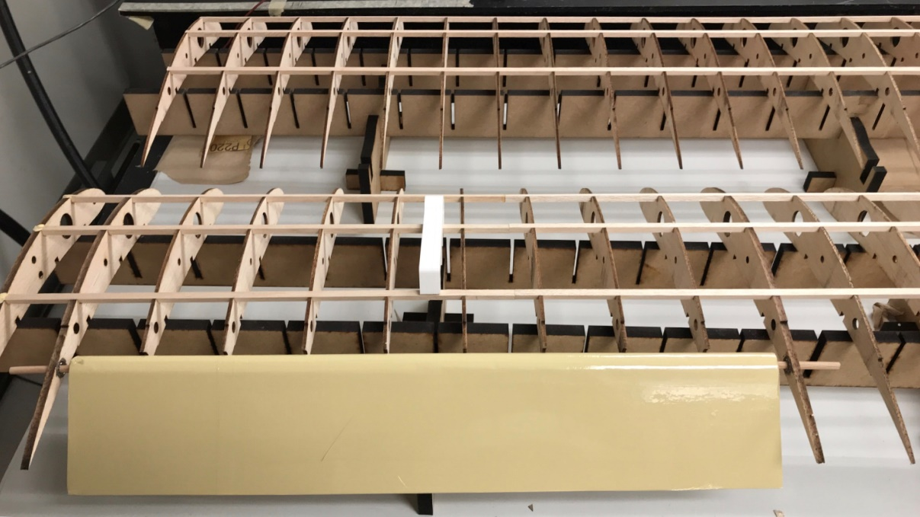
Manufacturing
Takes place in the Spring Term
Safety Training, Machining

Slide 9
Season outlook
Design Reviews
Gaant Chart (In progress)
Group Designs/SolidWorking
Utilizing Slack
My role

